Slide 1
HealthApp
Team 4:
Tarun Dagar
Riddhi Mhatre
Vivek Karhale
Sriharsha Mopidevi
Fernando Hernández
Jigarkumar R Patel
Aliaksandra Paliashchuk
Nishith Desai

Slide 2
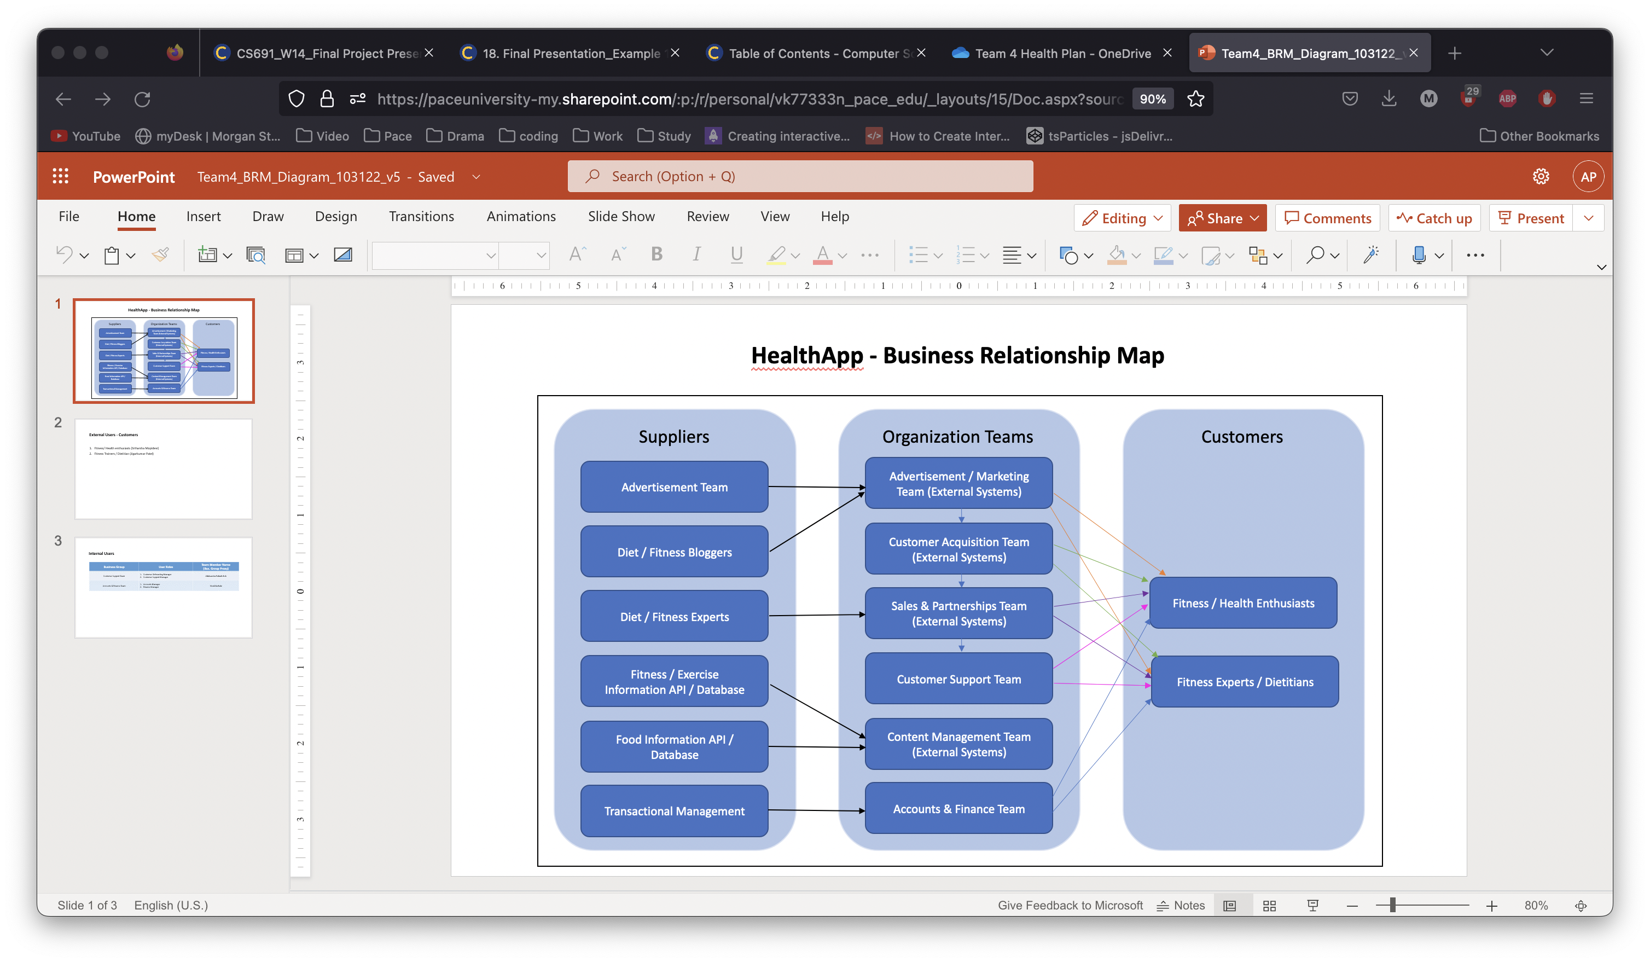
BRM Diagram – Aliaksandra Paliashchuk

Slide 3
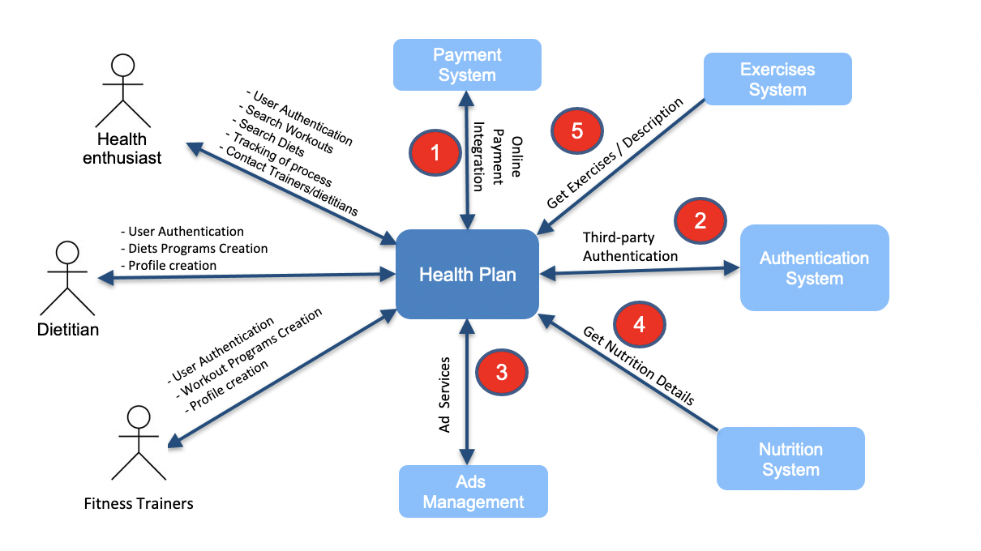
Context Diagram - Fernando Hernández

Slide 4
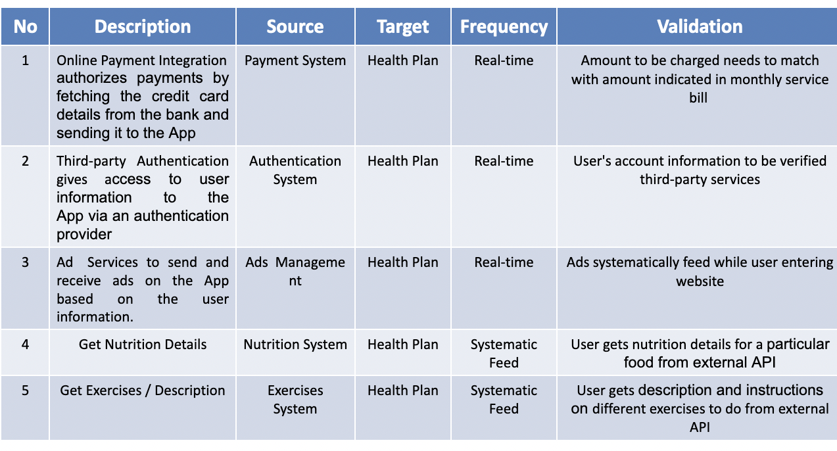
System Interface Table - Fernando Hernández

Slide 5
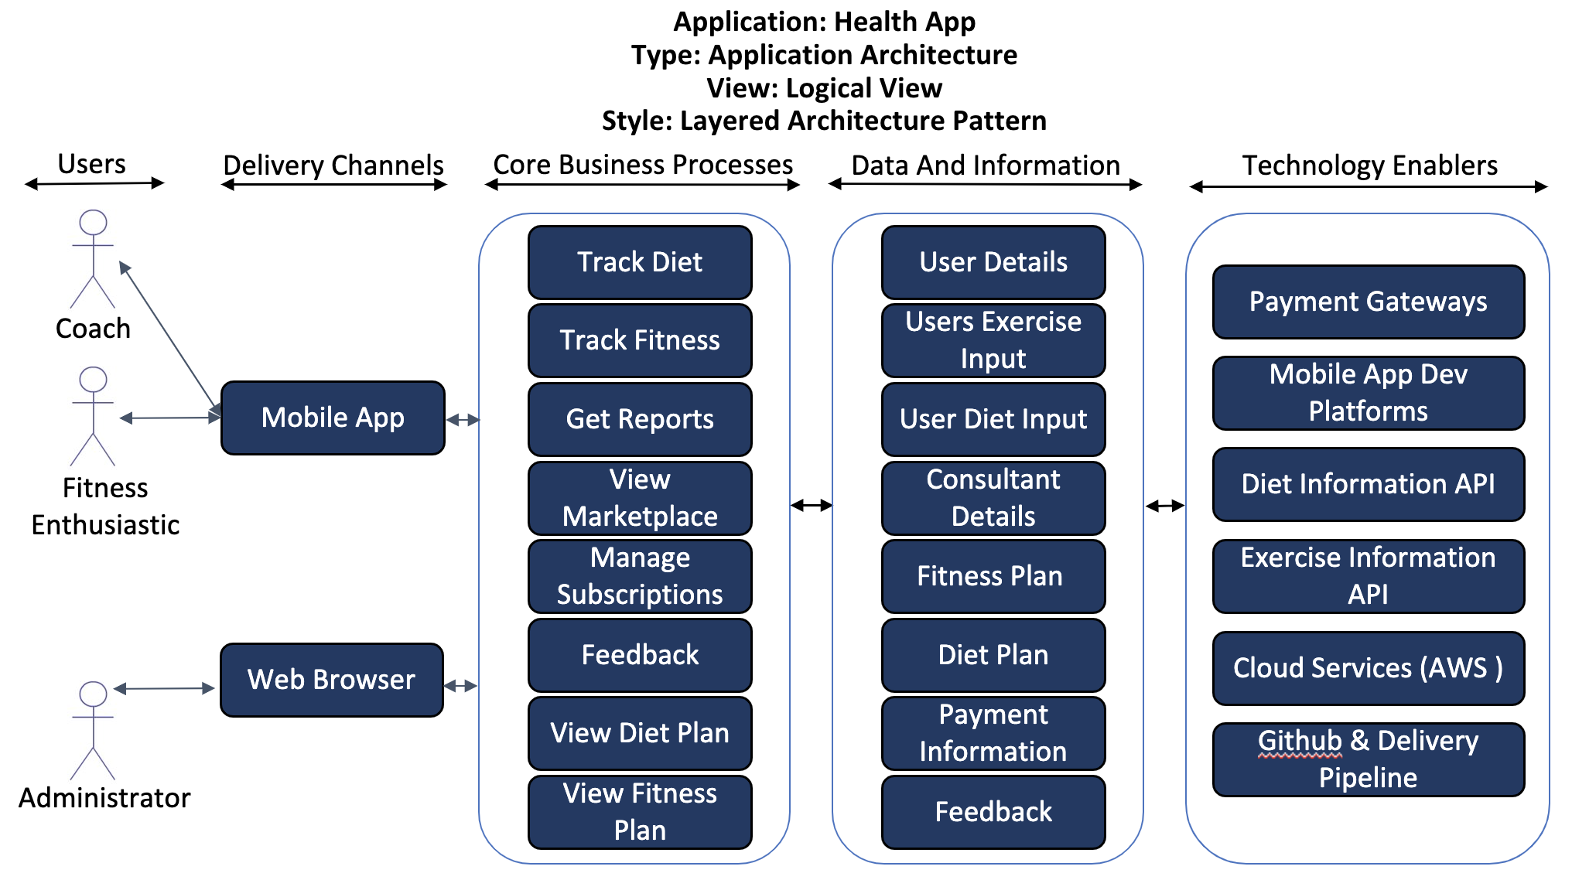
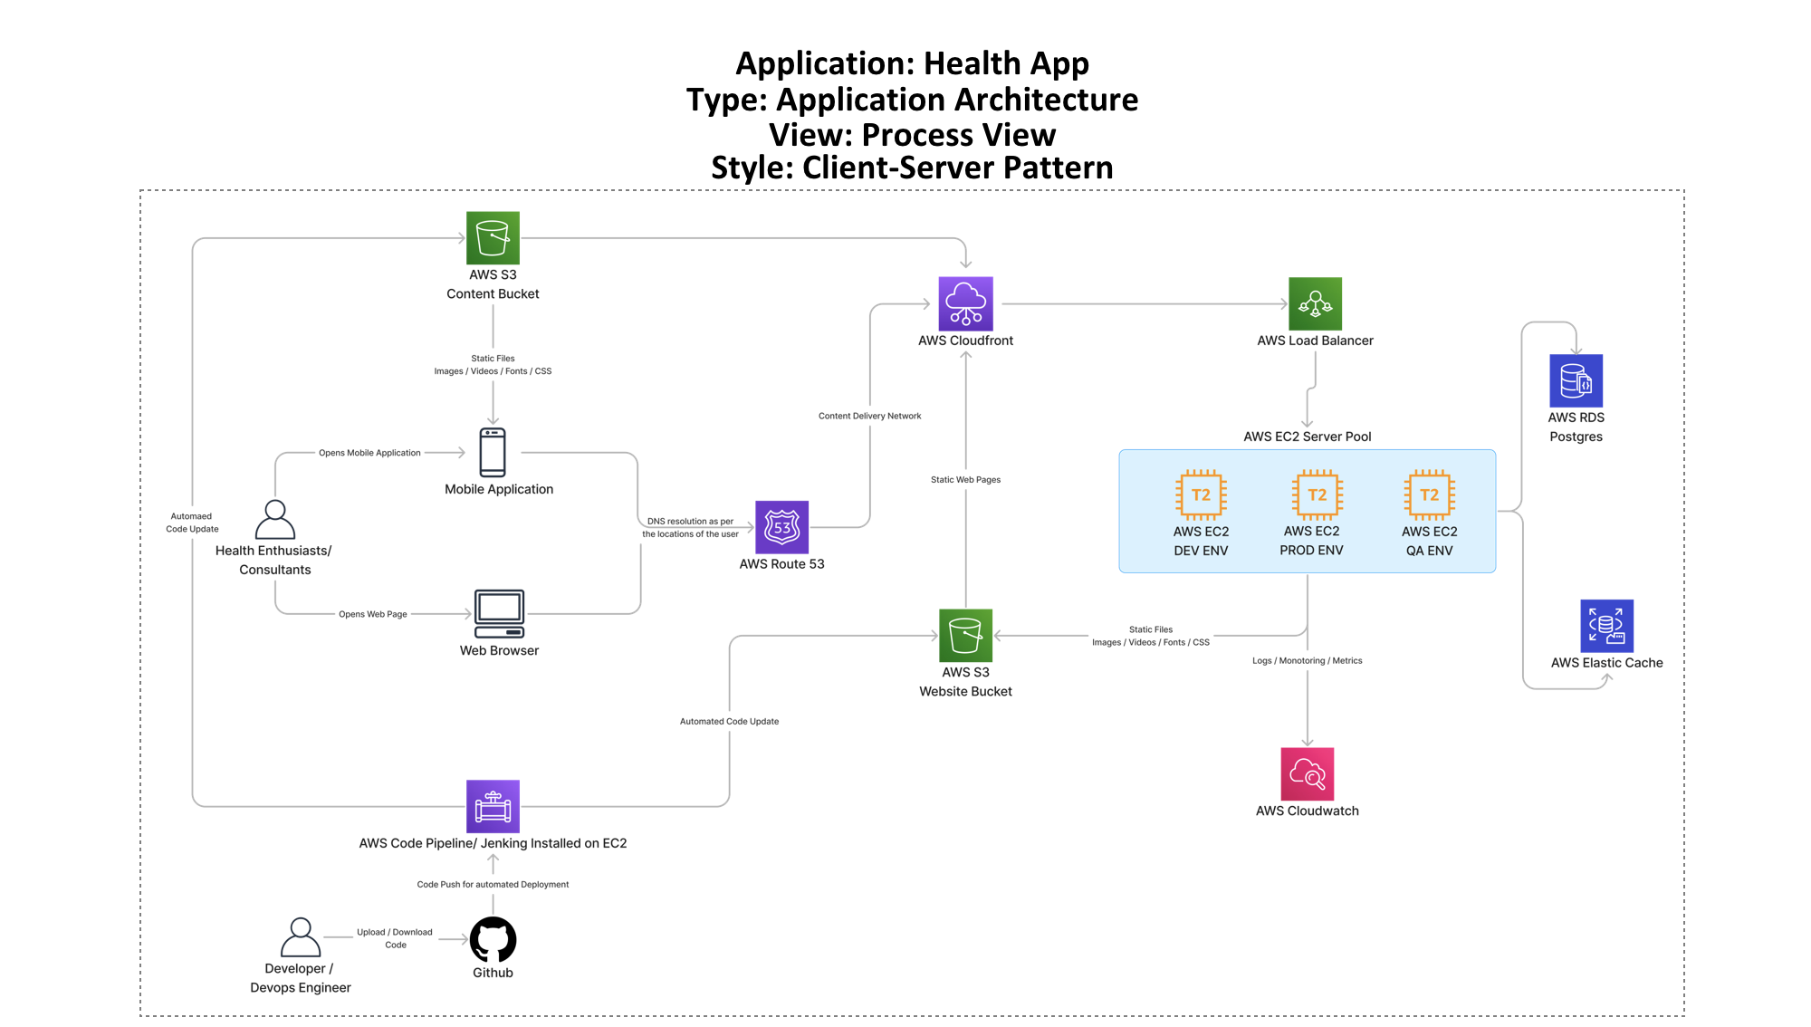
Architecture Diagrams - Tarun Dagar

Slide 6
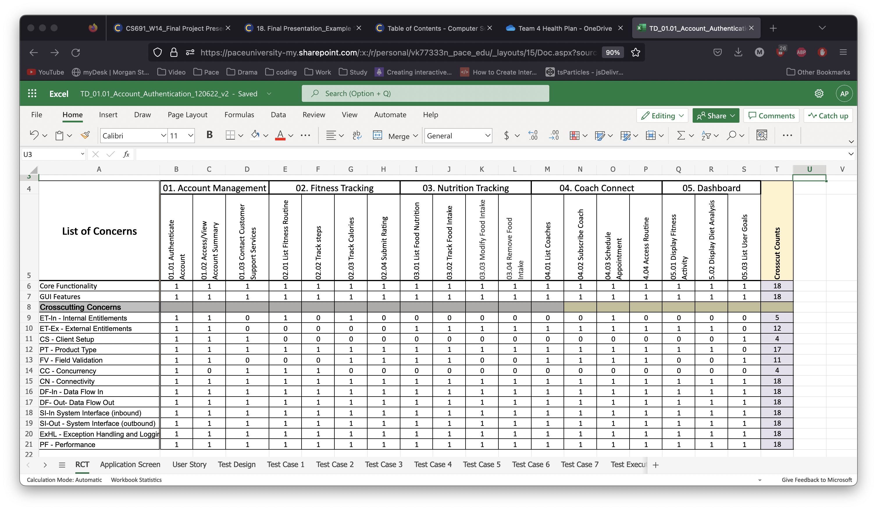
RCT - Vivek Karhale

Slide 7
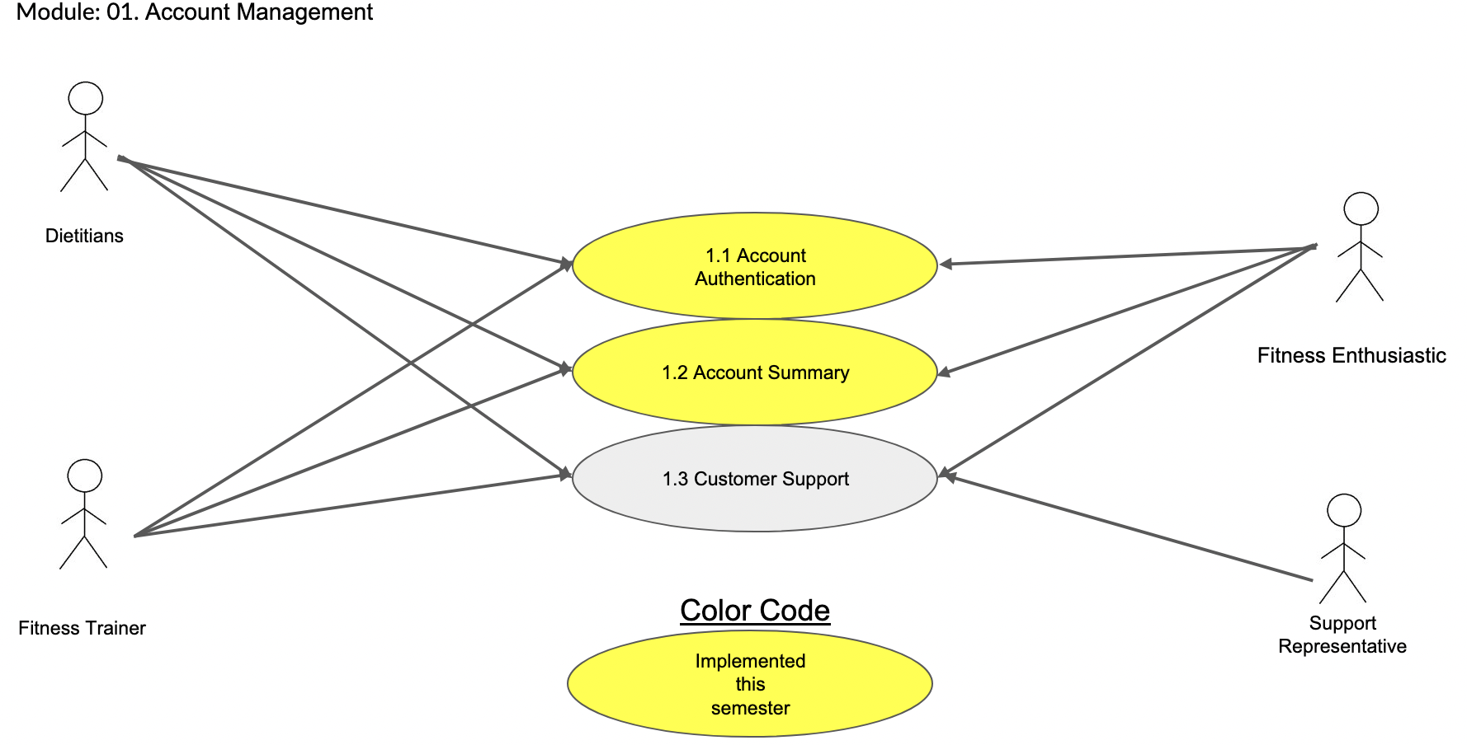
Use Case Diagram - Jigarkumar R Patel

Slide 8
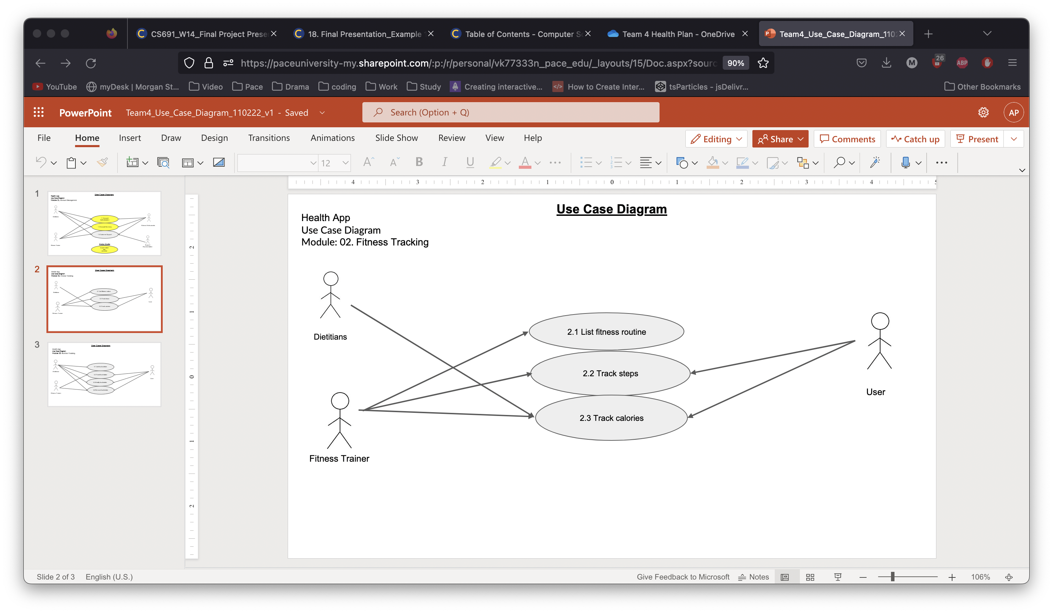
Use Case Diagram - Jigarkumar R Patel

Slide 9
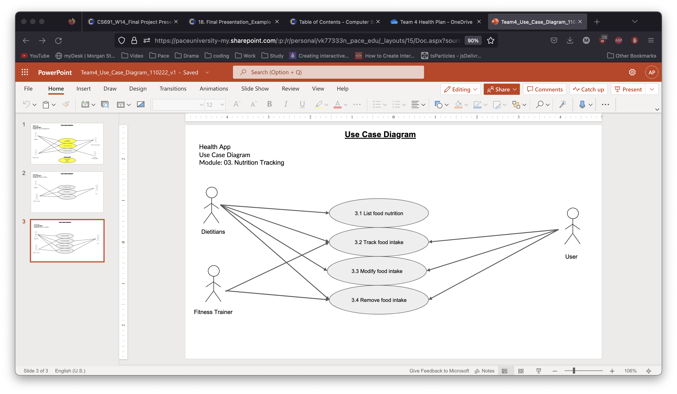
Use Case Diagram - Jigarkumar R Patel

Slide 10
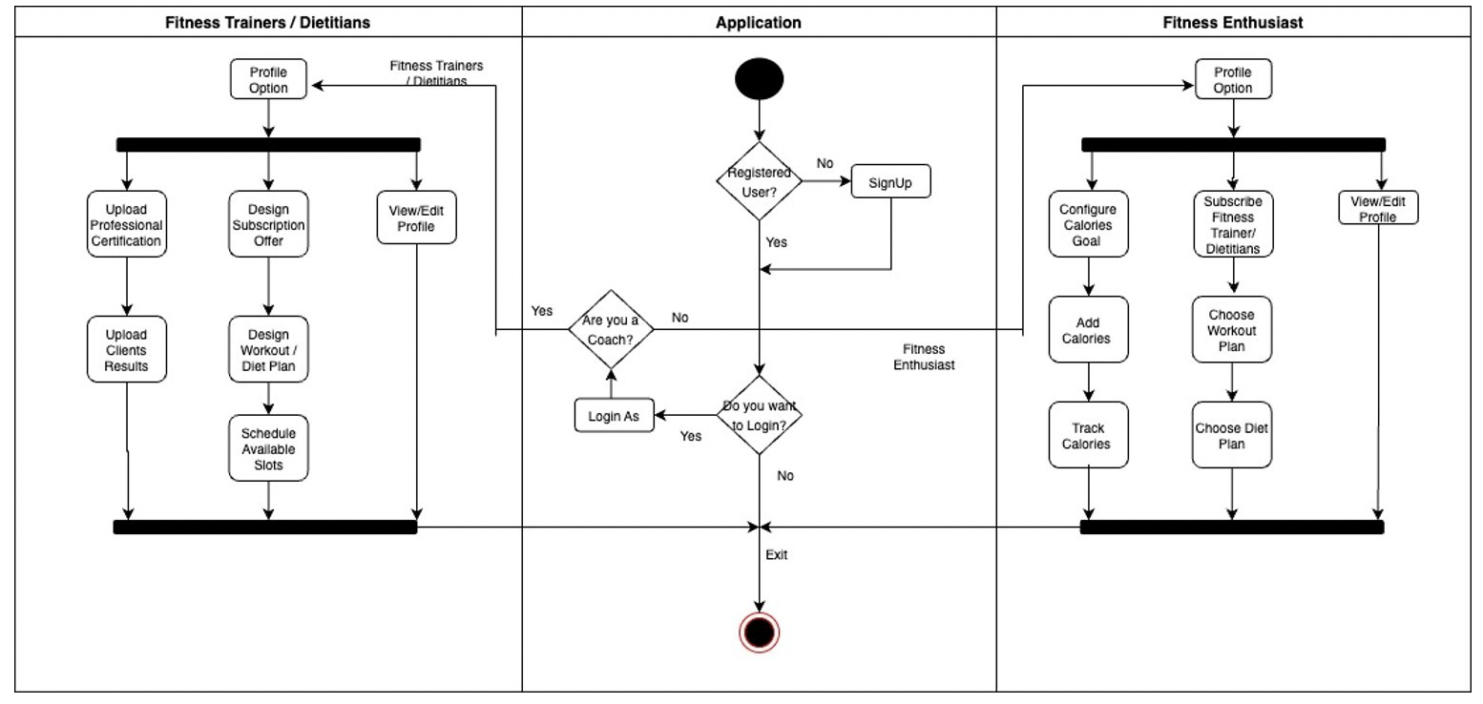
Activity Diagram - Riddhi Mhatre

Slide 11
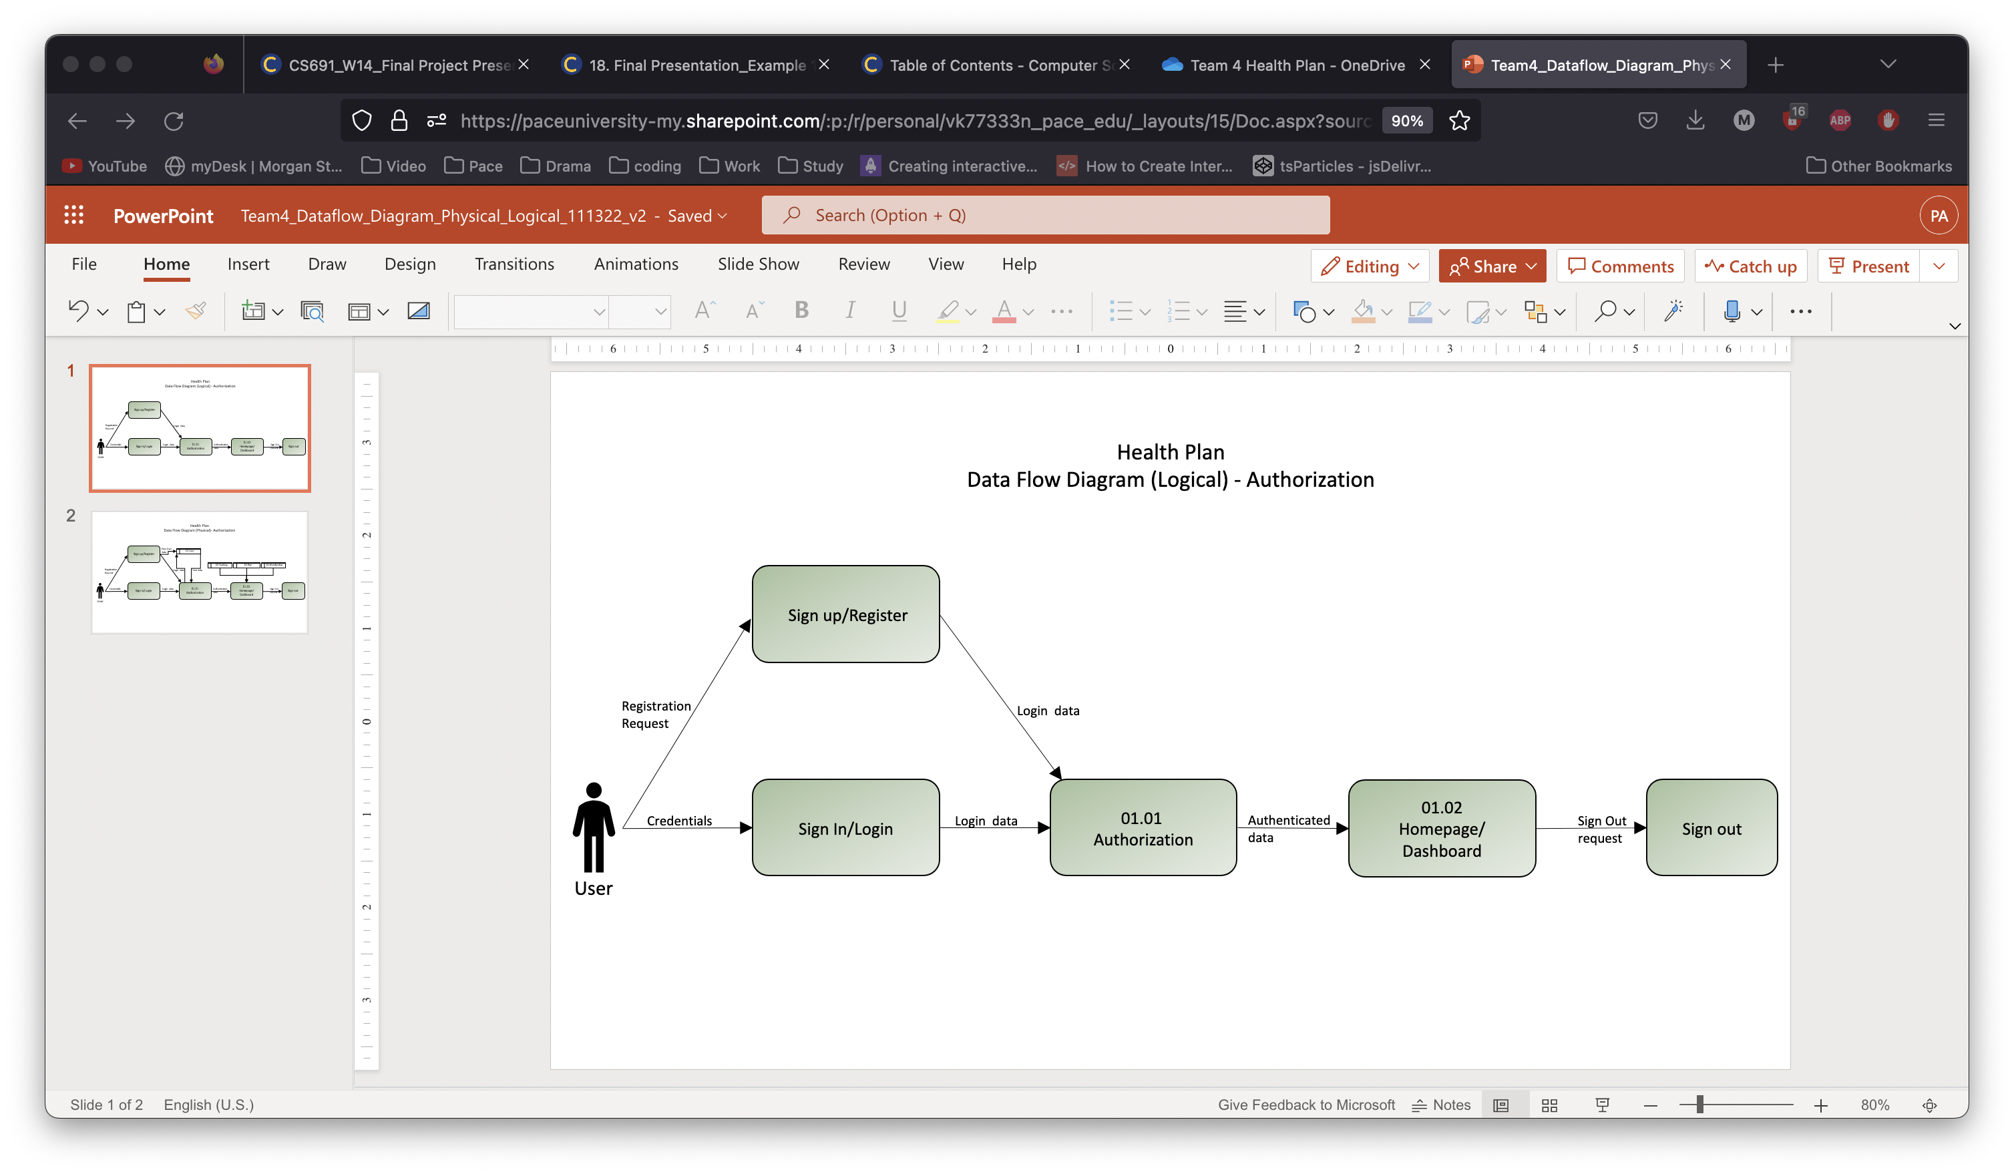
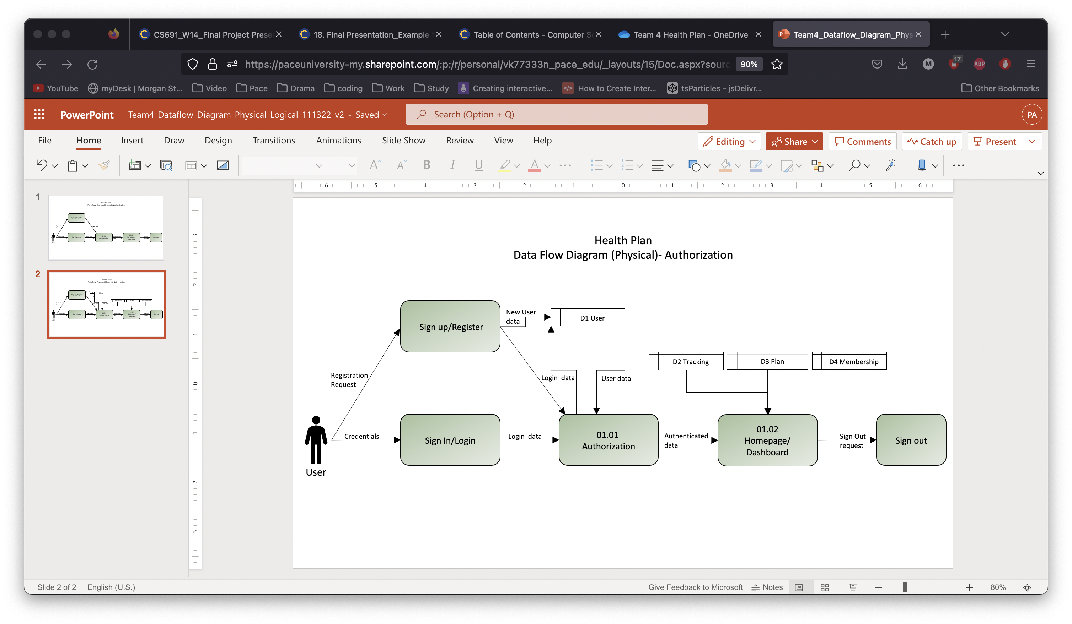
Data Flow Diagrams - Jigarkumar R Patel

Slide 12
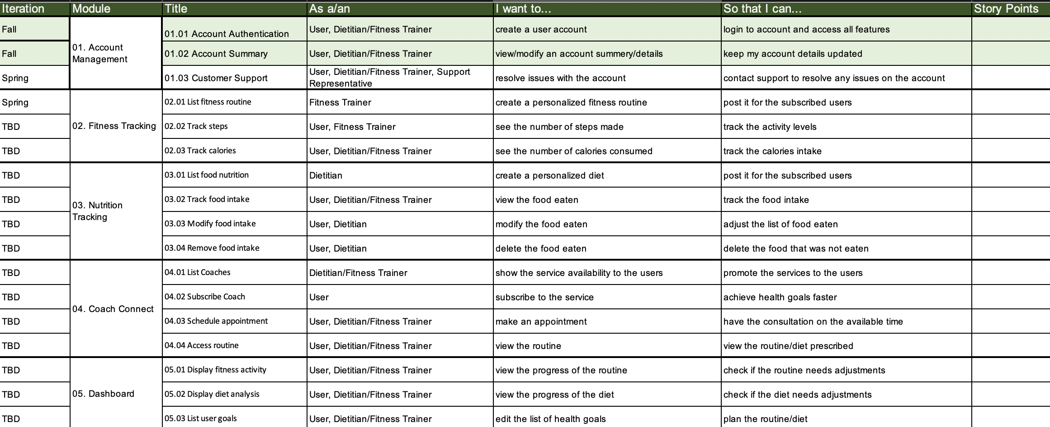
Functional requirements - Riddhi Mhatre

Slide 13
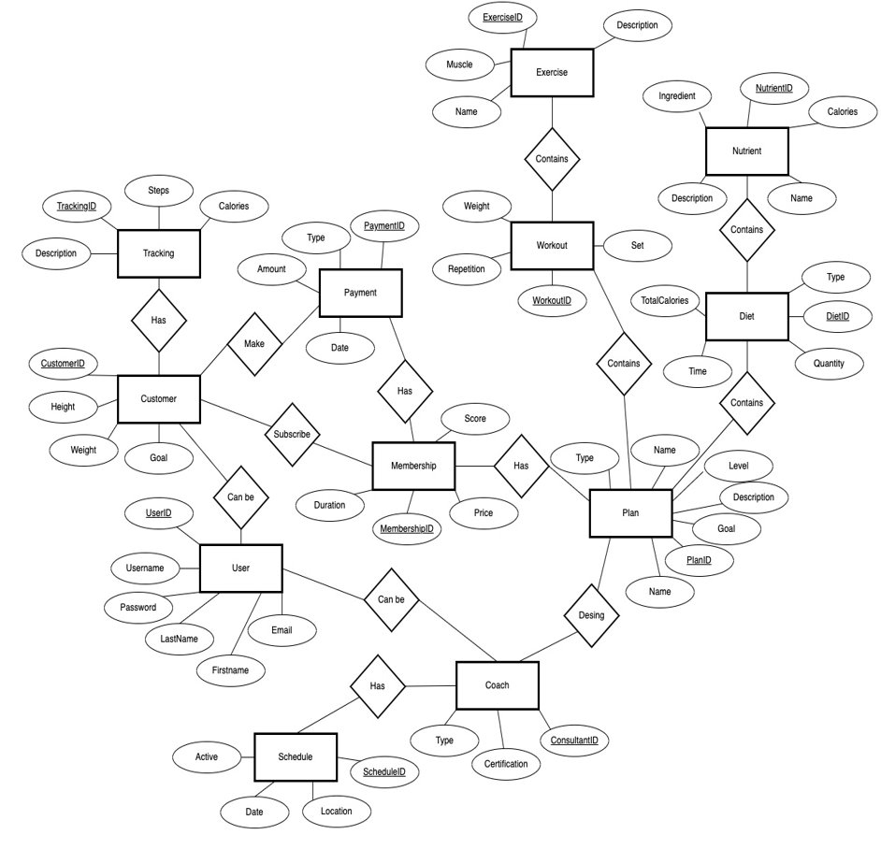
Er diagram (Conceptual) - Fernando Hernández

Slide 14
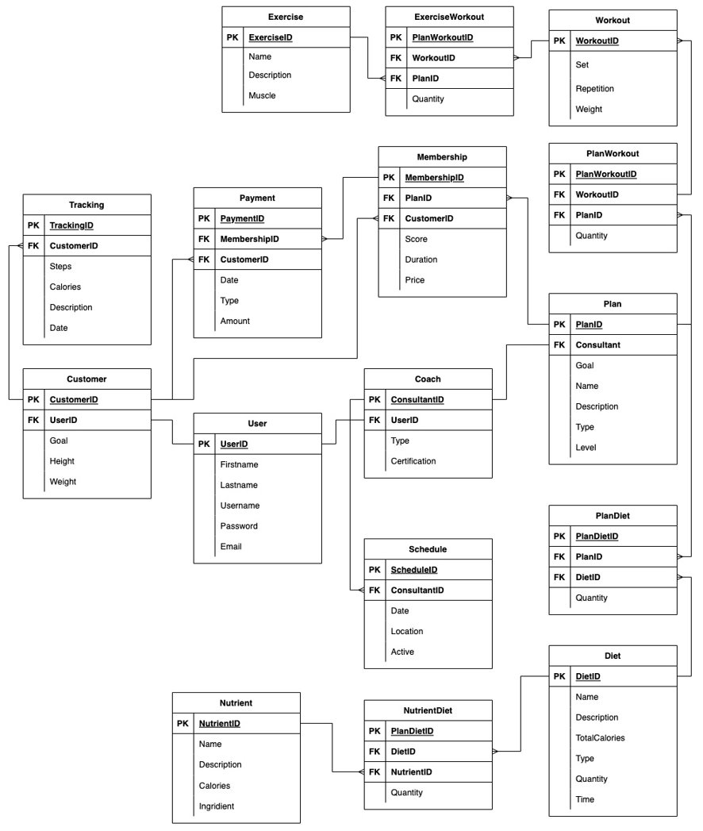
Er diagram (Logical) - Fernando Hernández

Slide 15
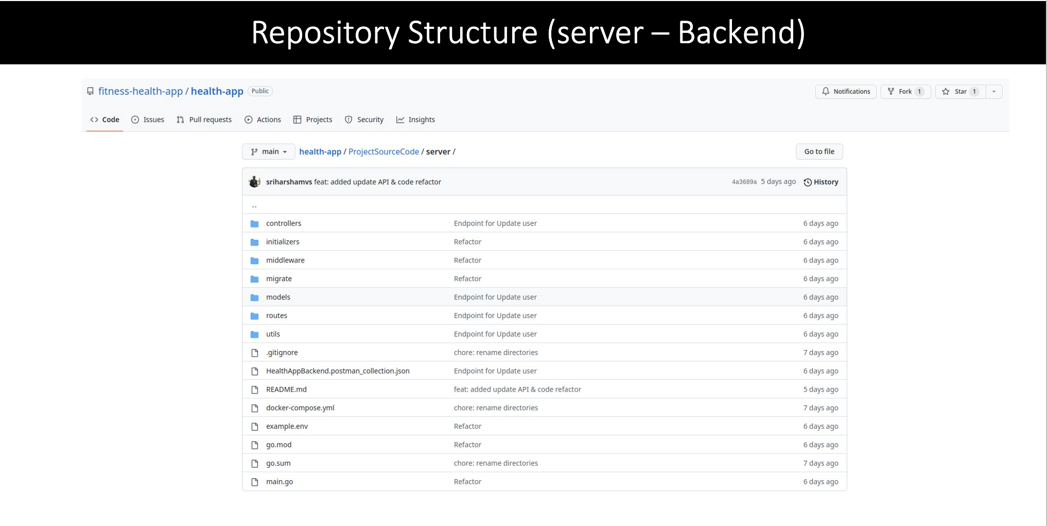
Source Code - Sriharsha Mopidevi

Slide 16
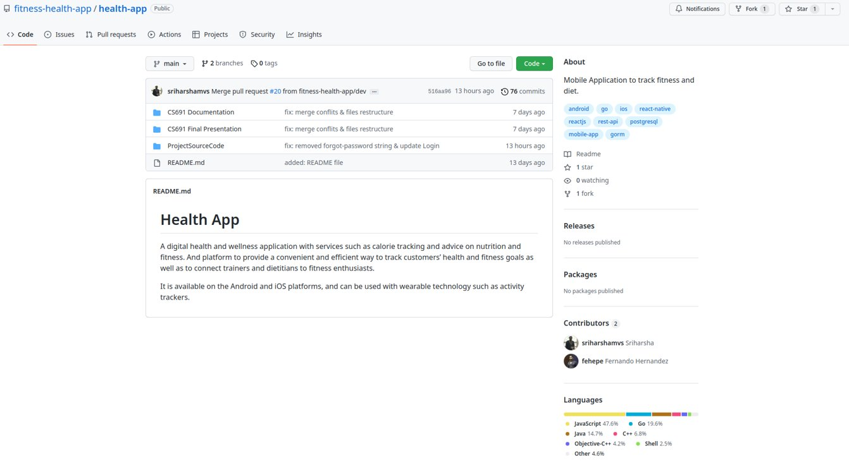
GIThub - Sriharsha Mopidevi

Slide 17
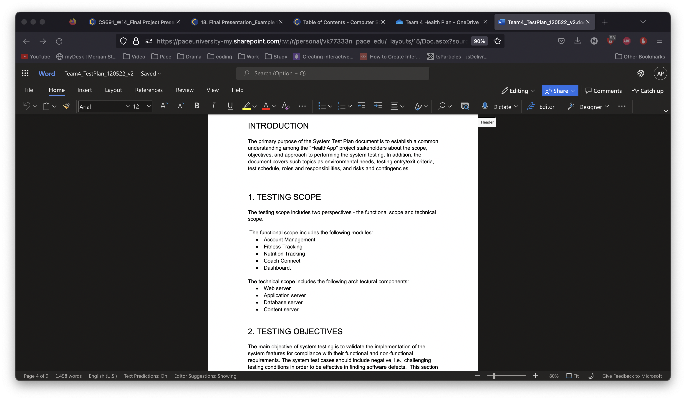
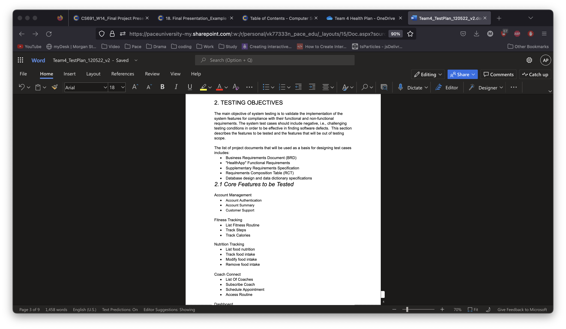
Test plan document - Nishith Desai

Slide 18
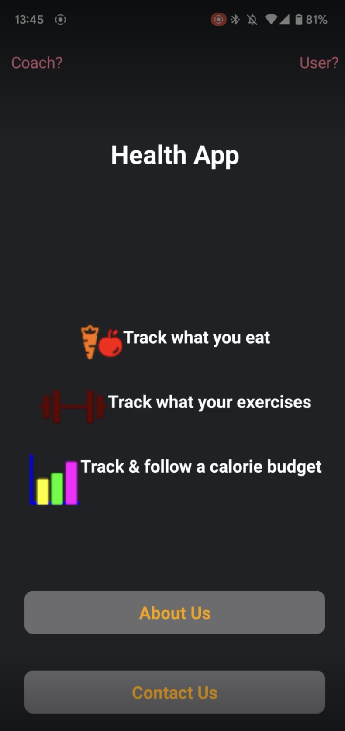
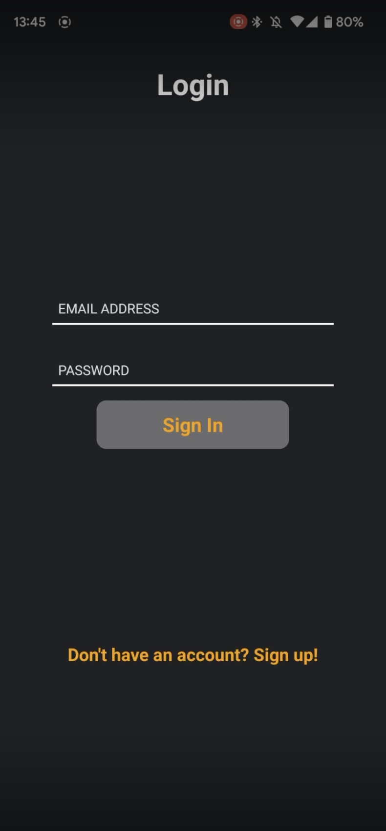
Application demo - Vivek Karhale

